Slide 1

2011 Symposium on Nuclear Data
Nuclear Data in Radiation Protection Dosimetry
Daiki SATOH
Japan Atomic Energy Agency
Contents
1. Dosimetry calculations powered by Nuclear Data.
2. Abnormalities of kerma coefficients in JENDL-4.
3. Neutron production cross sections at zero degrees
in JENDL/HE.
1

Slide 2
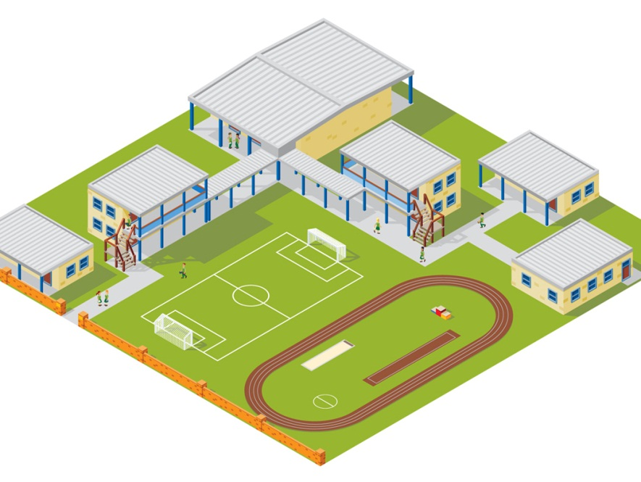
1. Dosimetry Calculations Powered by Nuclear Data
Calculation of Dose Conversion Coefficients (DCC) for external exposure to
radionuclides in air, water, and soil.
Radioactive plume
Fukushima Dai-ichi Nuclear Power Plant
Submersion in a contaminated
atmospheric cloud (air submersion)
Immersion in contaminated water
(water immersion)
Exposure to contamination on or in
the ground (ground exposure)
2

Slide 3
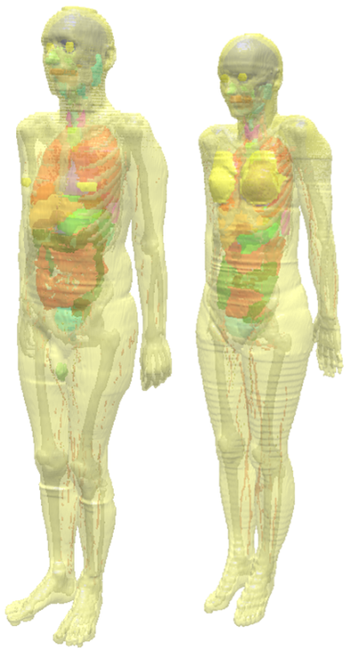
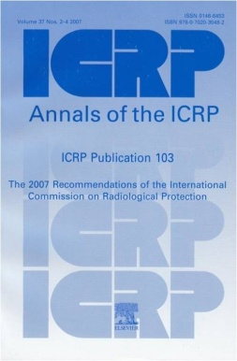
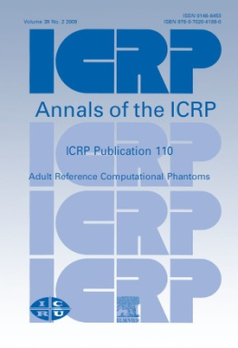
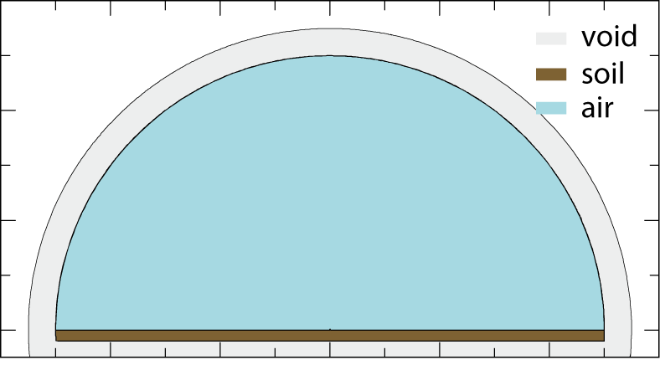
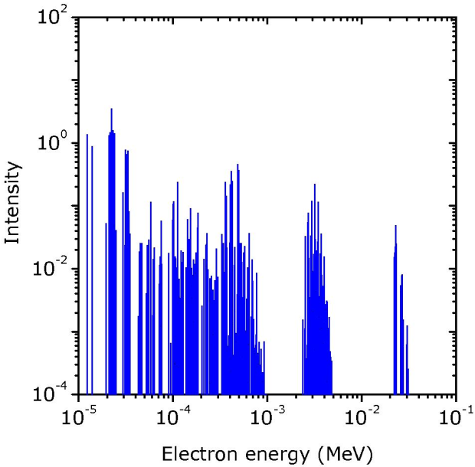
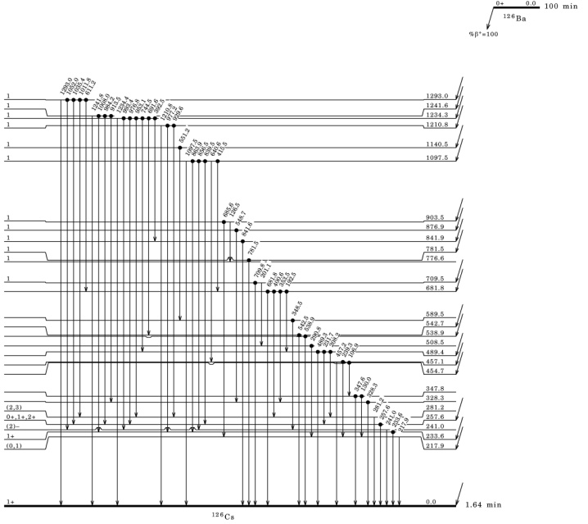
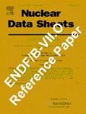
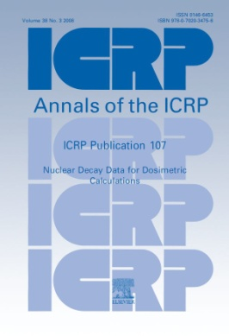


Calculation method
DCC for monoenergetic
photons or electrons
Radiation transport in the environment
Radiation fields from …
semi-infinite cloud source,
infinite water source,
contaminated soil source.
Publ.103
2007
Publ.110
2009
$$w_{T},$$
$$w_{R}$$
Reference
phantom
DCC from radionuclides
in the environment
Radius = 5×MFP(E)
ENSDF
(e.g. 1.0MeV photon;
MFP = 130 m, Radius = 650 m )
PHITS
Photo-atomic data library
(mcplib04)
Electron data library
ENDF
(el03)
Decay data
Publ.107
2008
EPDL97
3

Slide 4
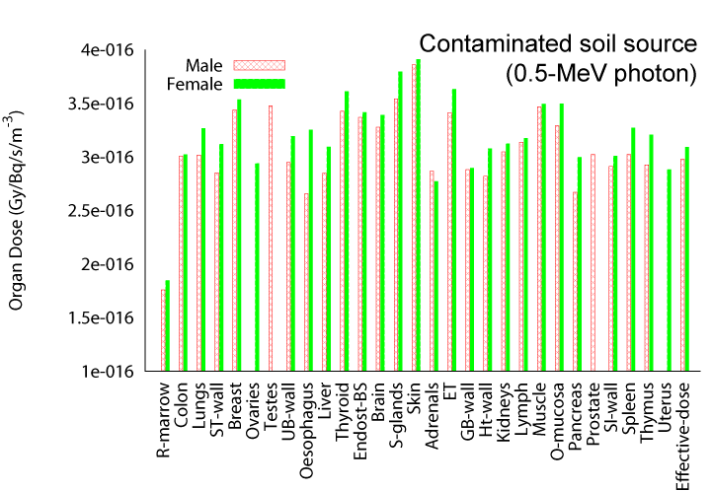
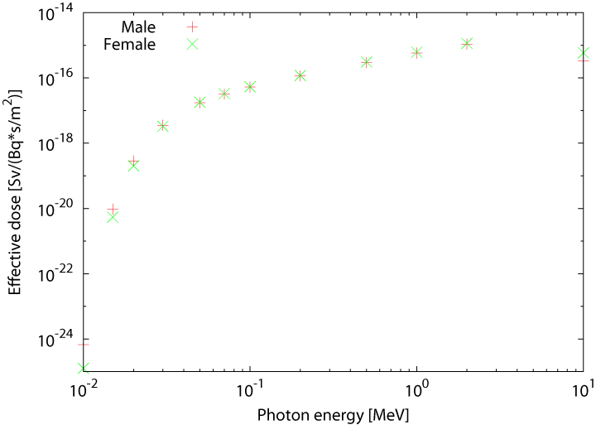
Organ absorbed doses
from the contaminated soil source
DCC for monoenergetic photons
from the contaminated soil
Preliminary
4

Slide 5
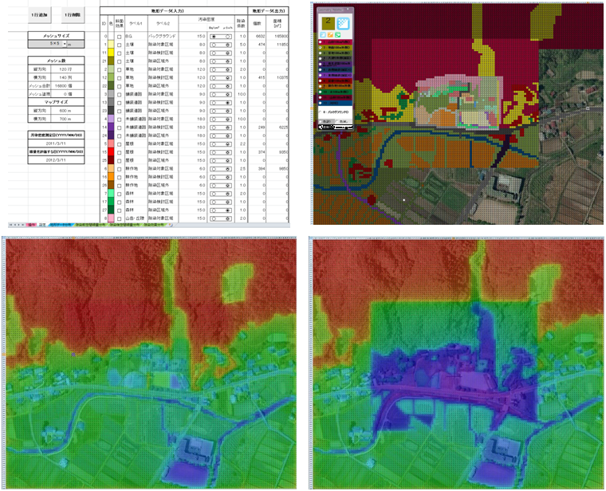
Development of a Calculation system for Decontamination Effect (CDE).
http://nsed.jaea.go.jp/josen/
5

Slide 6
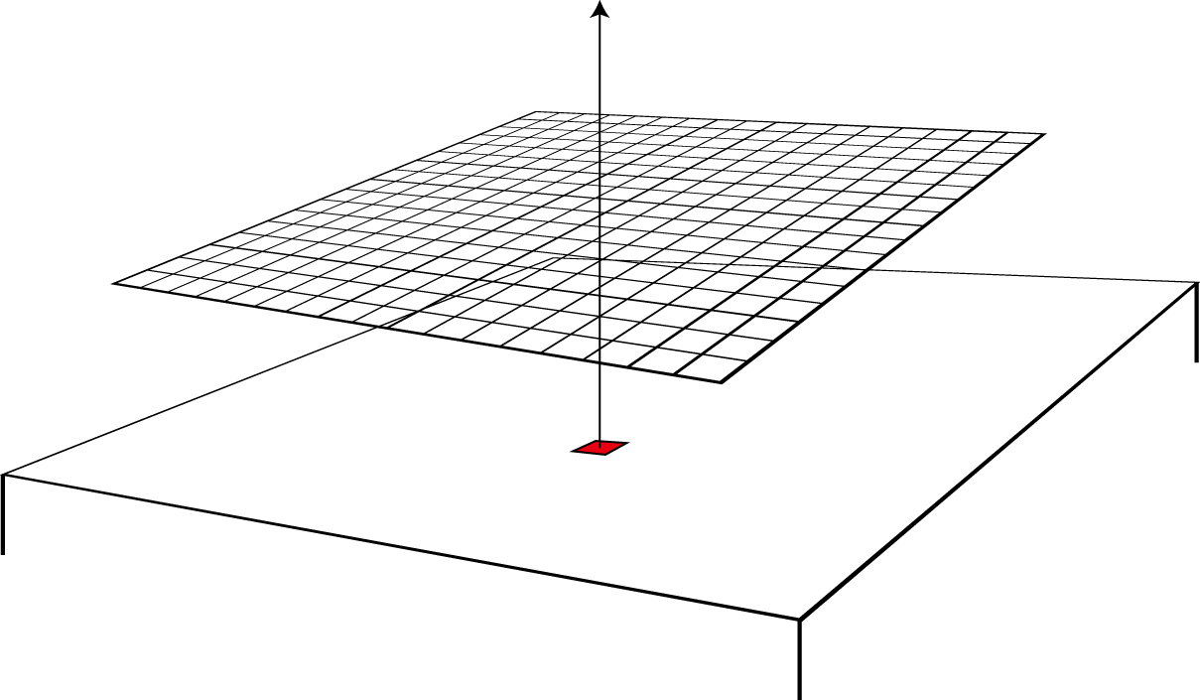
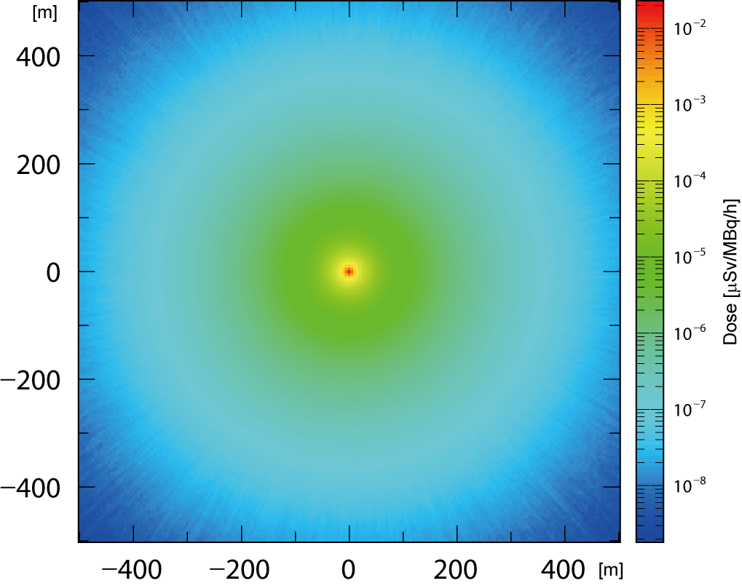
Calculation method
Atmosphere
1005m
Scoring
mesh
Use of PHITS and Nuclear Data Library
for dose contribution simulation from
contaminated soil Including sky-shine
and ground-shine effects.
1005m
Source (¹³⁷Cs, ¹³⁴Cs)
Soil
Construction of Response Matrix on
the basis of the PHITS calculation.
Simulation geometry
of semi-infinite soil and atmosphere
Response matrix:
Dose contribution per unit activity from the
central source region to the peripheral area.
Estimation of the dose rate distribution
from the activity map on the contaminated
environment by using the response matrix.
The forest and steep slope effect to dose
rate is taken into account.
Response matrix
http://nsed.jaea.go.jp/josen/
6

Slide 7
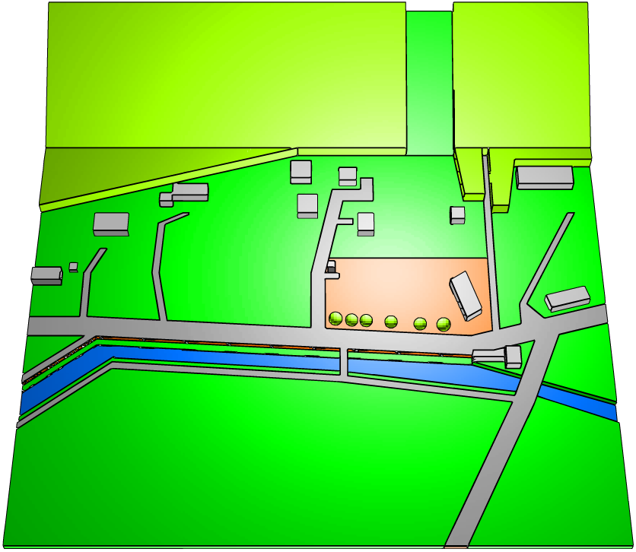
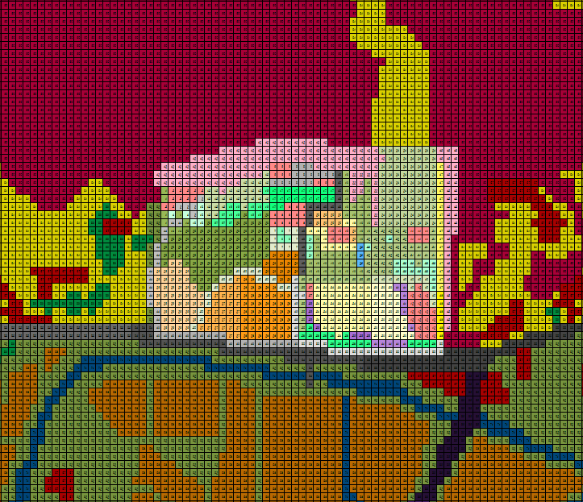
D
C
A2
A1
B2
B1
PHITS (3D)
CDE (2D)
Unit: μSv/h
 | A1 | A2 | B1 | B2 | C | D
CDE | 1.1 | 2.1 | 1.6 | 1.9 | 2.0 | 1.8
PHITS | 0.8 | 2.0 | 1.5 | 1.7 | 2.0 | 1.7
http://nsed.jaea.go.jp/josen/
7

Slide 8
Short summary
Thanks to the great works of nuclear data communities,
results of dosimetry calculation are maintaining high precision.
The photo-atomic data library mcplib04 (official released in 2002
based on ENDF/B-VI) will be upgraded to mcplib05 in the next
MCNP6 to take the complete form-factor data available in ENDF/
B-VII into account.
What does JENDL do?
8

Slide 9

2. Abnormalities of kerma coefficients in JENDL-4
Kerma (Kinetic energy released per unit mass)
The sum of the initial kinetic energies of all the charged particles liberated by
uncharged particles in a mass of material.
(ICRU Report 60, 1998)
The kerma coefficients $k_{Φ}(E)$ can be calculated from microscopic cross sections;
j: nuclide type, i: reaction type,
$N_{j}$: nuclei number of type j per unit mass,
$ε_{ij}$: average energy transferred to charged particles,
$σ_{ij}$: cross section in nuclear reaction type i and nuclei of type j.
Evaluation
Evaluated
Nuclear Data
Calculation
Kerma
Coefficients
NJOY
9

Slide 10
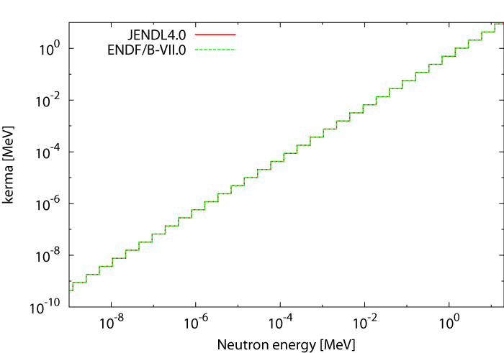
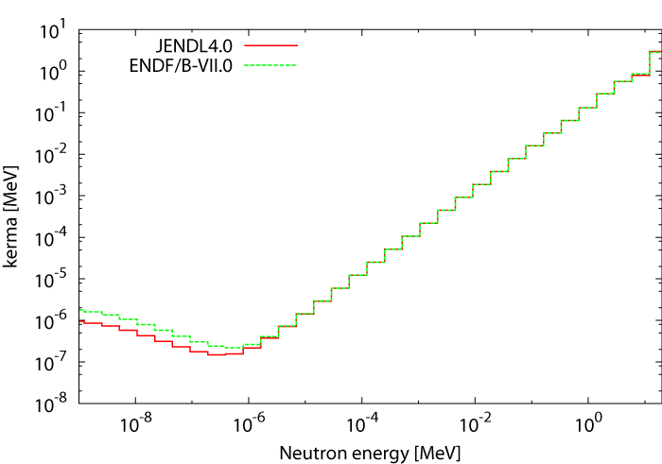
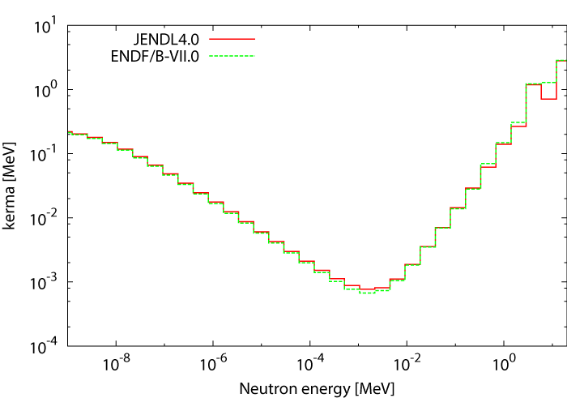
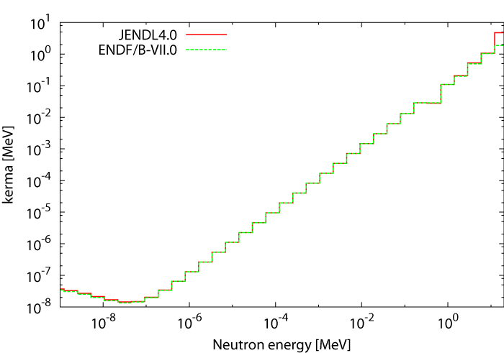
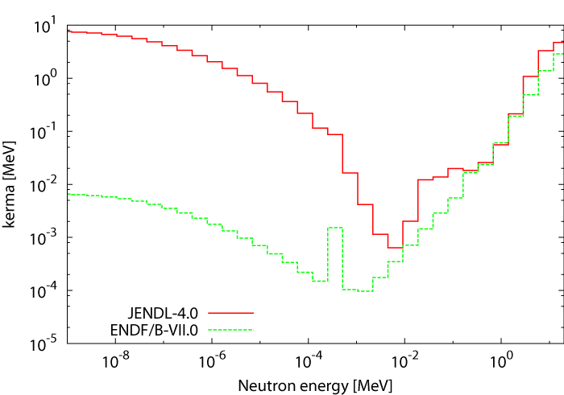
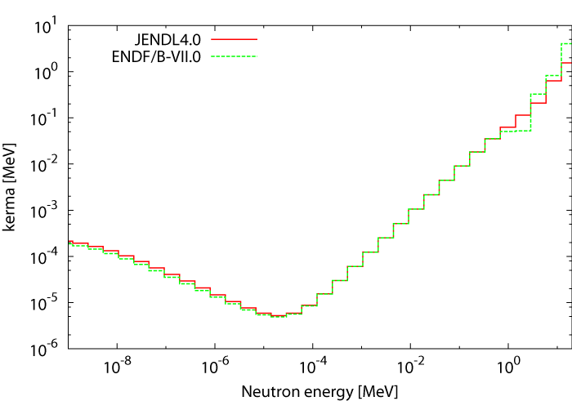
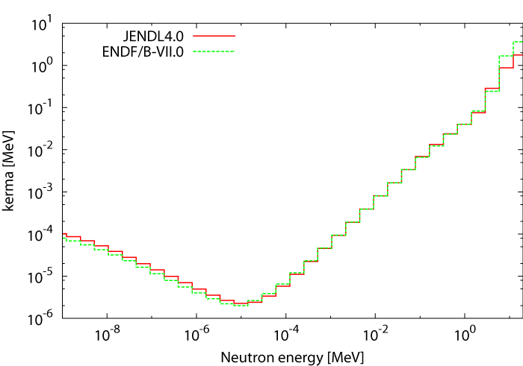
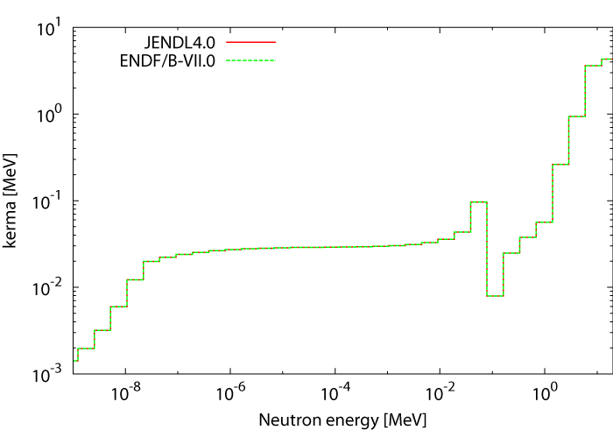
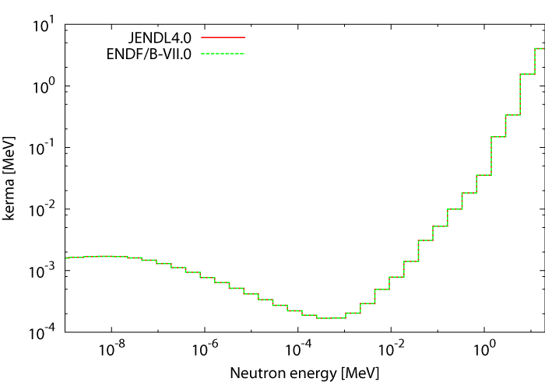
Elemental composition of muscle tissue.
 | H | C | N | O | Na | P | S | Cl | K
Wt % | 10.2 | 14.2 | 3.4 | 71.1 | 0.1 | 0.2 | 0.3 | 0.1 | 0.4
(ICRP Publ. 110, 2009)
H
C
N
O
Cl
Na
P
S
K
ENDF/B-VII.0;
Chadwick MB, “A consistent set of neutron kerma coefficients from thermal to 150 MeV
for biologically important materials”, Med. Phys., 26(6), 974-91, 1999.
10

Slide 11
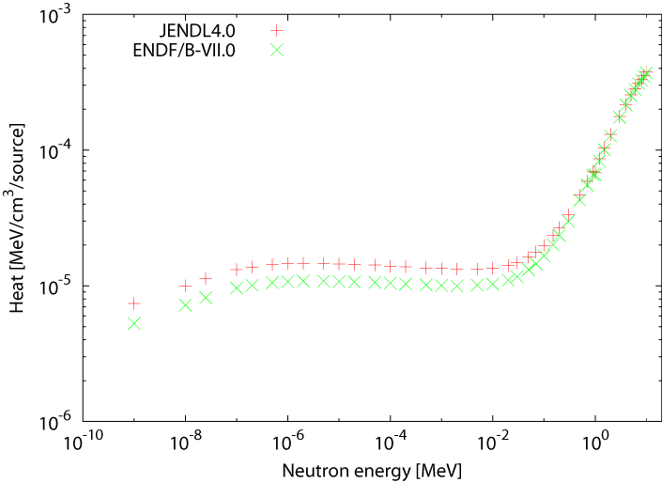
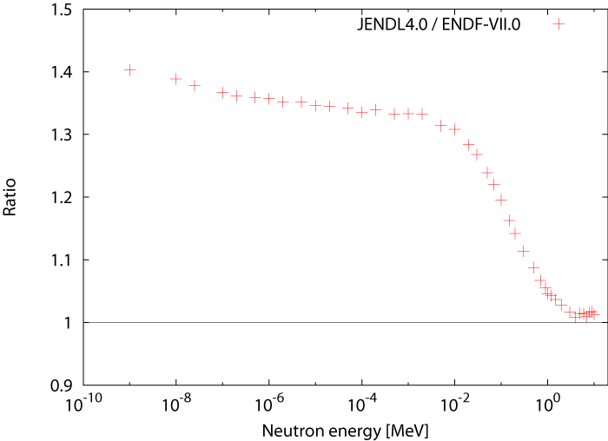
Calculation of the HEAT inside a tissue equivalent sphere with kerma approximation.
Neutron flux (10⁻⁹ - 10 MeV)
JENDL-4.0
ENDF/B-VII.0
(H, C, N, O, Na, P, S,
Cl, K)
Tissue equivalent sphere
(diameter = 30 cm)
11

Slide 12
Short summary
JENDL-4 overestimates the kerma coefficients of Cl.
This leads to the overestimation of absorbed doses inside
a human body.
Who has the responsibility
for the evaluation of kerma coefficients?
Evaluated
Nuclear Data
Kerma
Coefficients
12

Slide 13
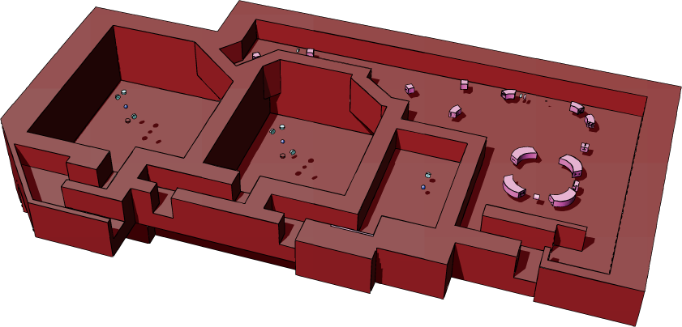
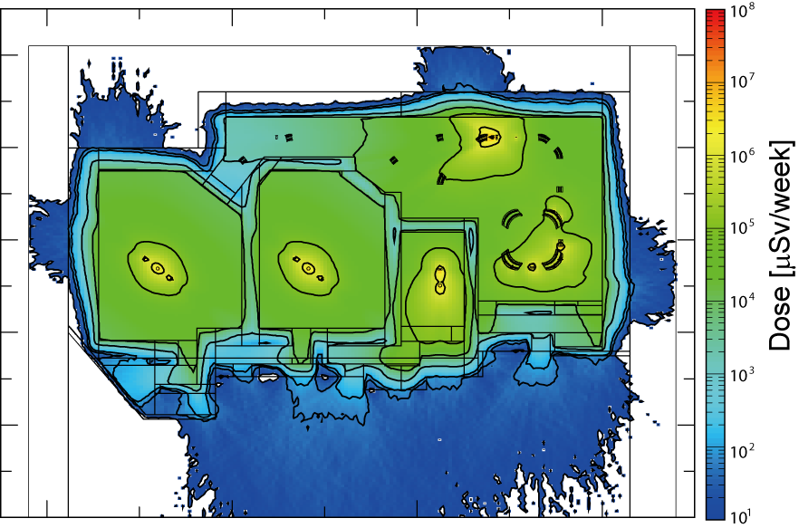
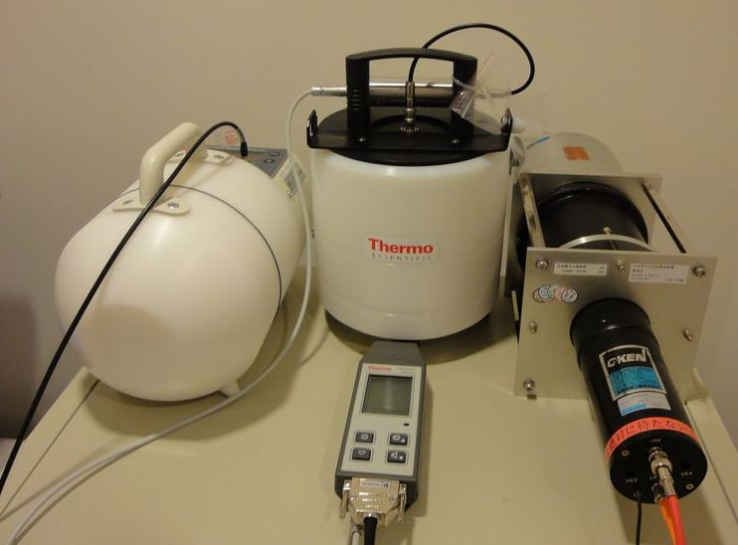
3. Neutron production cross sections at zero degrees
in JENDL/HE
Proton therapy center of
Fukui prefectural hospital
Synchrotron
235-MeV proton beam
Horizontal irradiation room : 1
Gantry room : 2
13

Slide 14
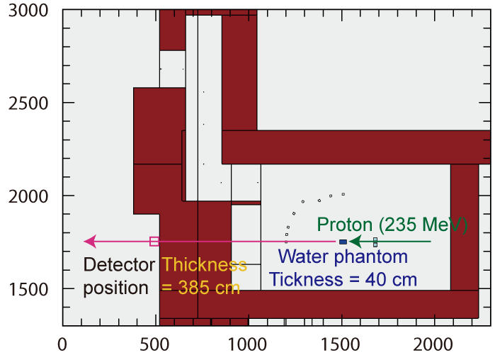
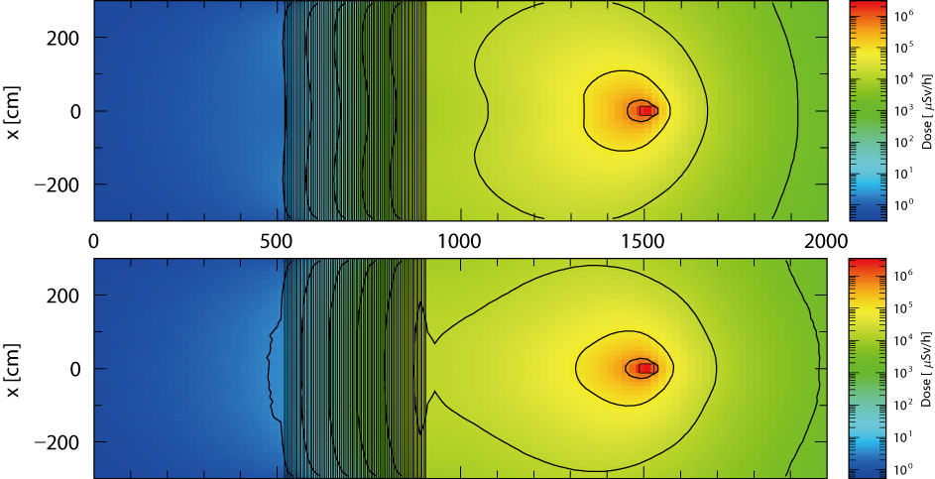
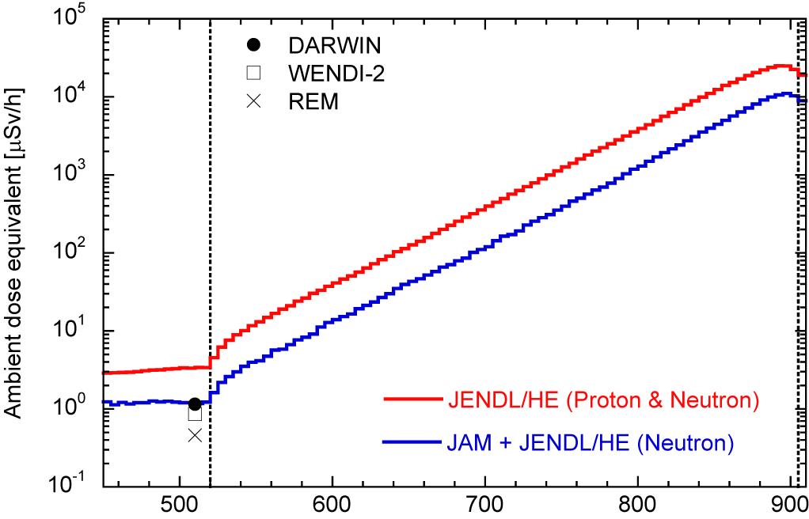
JAM
JENDL/HE
Concrete wall (385 cm)
14

Slide 15
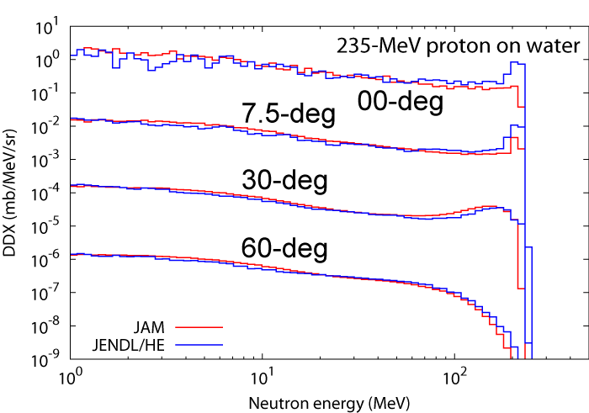
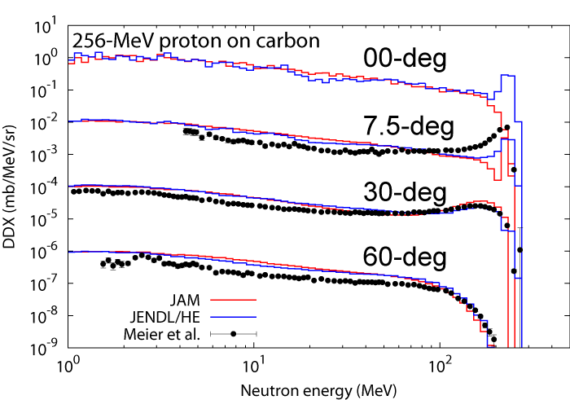
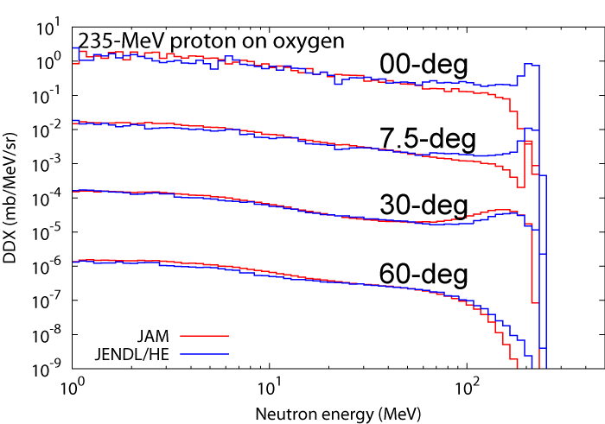
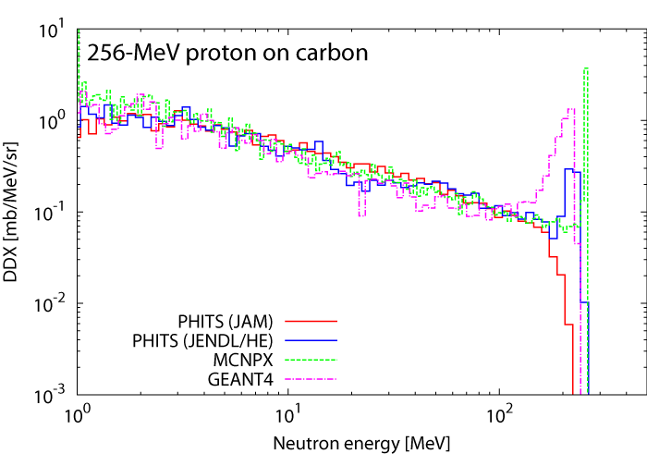
Neutron production double differential cross sections
15

Slide 16
Short summary
JENDL/HE would be suitable to use in shielding design
at accelerator facilities.
But, JENDL/HE and theoretical modes fail to reproduce the
neutron-production double differential cross sections at zero
degrees.
To overcome this bad situation, systematic data set of the
cross sections are required…
We plan to measure the neutron-production
double-differential cross sections in most-
forward direction.
Please wait for a little while longer.
16

Slide 17
Summary
Various kinds of nuclear data are utilized in the study of
radiation protection dosimetry.
Nuclear data are essential for dosimetry calculations
to ensure the accuracy of the results.
Some problems would be remained in the current nuclear
data and the subset of the libraries.
I believe…
Collaborations across the fields of nuclear data and
radiation protection would solve these problems, and
lead us to the better future!
17

Slide 18
Collaborators
Calculation of the dose conversion coefficients for external photon exposure
from the contaminated environment.
Akira Endo
Development of the calculation system for decontamination effect.
Kensuke Kojima, Akito Ohizumi, Norihiro Matsuda, Hiroki Iwamoto,
Teruhiko Kugo, Yukio Sakamoto, Akira Endo, and Shigeaki Okajima.
Measurement of the neutron doses at the proton therapy center of
Fukui prefectural hospital.
Yuji Tameshige, Yoshikazu Maeda, Shuichi Tsuda, Akira Endo,
Hiroshi Nakashima, Tokushi Shibata.
18

